Slide 1
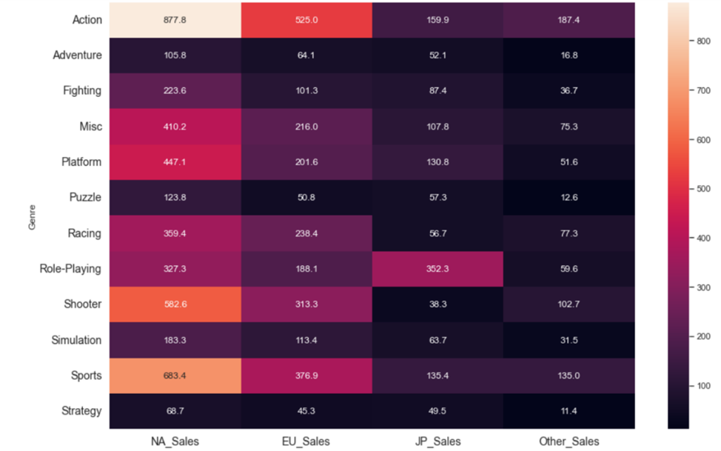
Video Game Sales Visualization From 1980 to 2017 By Genre and Region
Heat map
The darkness of the color of each cell represents the total amounts of sales.
Lighter color represents higher amounts of sales and darker color represents lower amount of sales.
Data gathered from: https://www.kaggle.com/datasets/gregorut/videogamesales

Slide 2
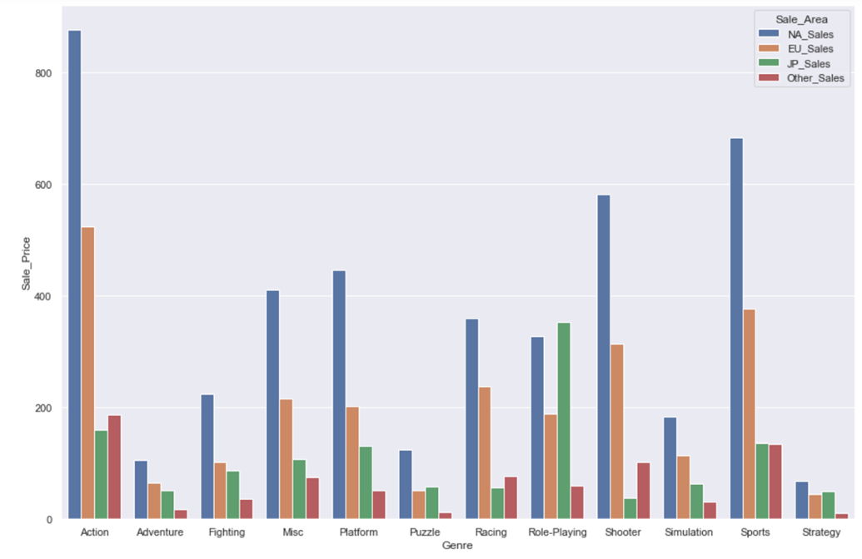
Video Game Sales Visualization By Genre and Region From 1980 to 2017
Bar Chart
The blue bar represents North America
The orange bar represents Europe
The green bar represents Japan
The red bar represents all other regions in the world
Data gathered from: https://www.kaggle.com/datasets/gregorut/videogamesales

